Slide 1
Orange Egypt
Presented By :
Ahmed Bhaa – First Class Assist team
Reviewed By :
Yomna Alaa El-Din
Hend Khalil

Slide 2
Roaming Troubleshooting Guide

Slide 3
1- Cannot Make or Receive calls :

Slide 4
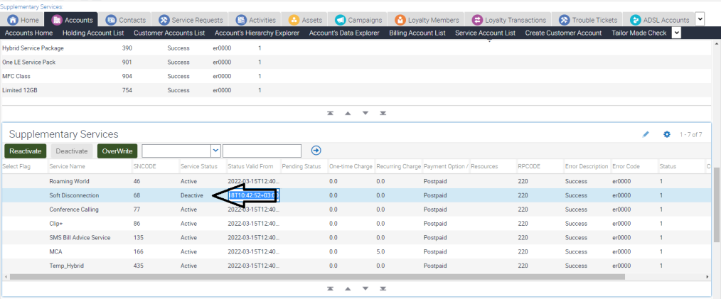
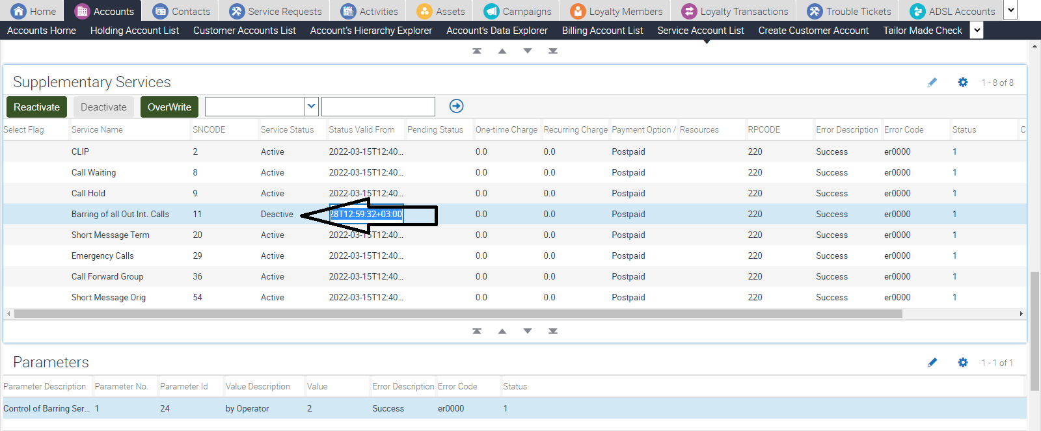
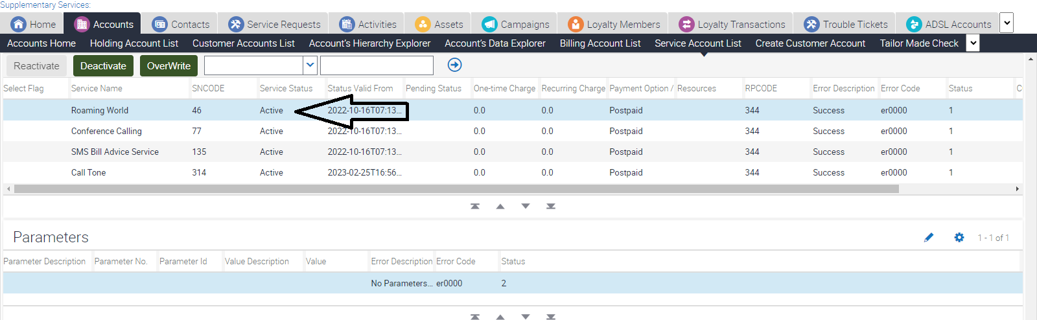
Troubleshooting Steps :
1- You must make sure customer has no active SD or suspension, active roaming world and barring of all our international calls is deactivated. Below screenshots of needed actions :

Slide 5
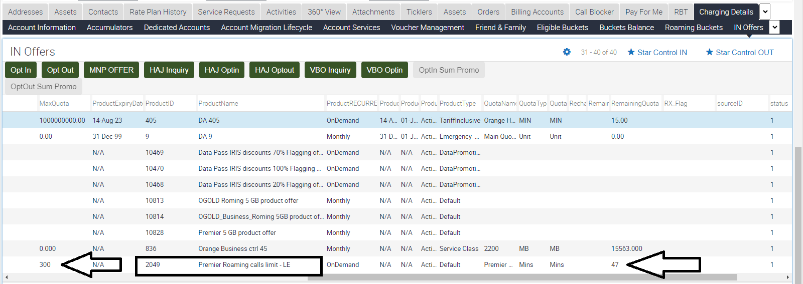
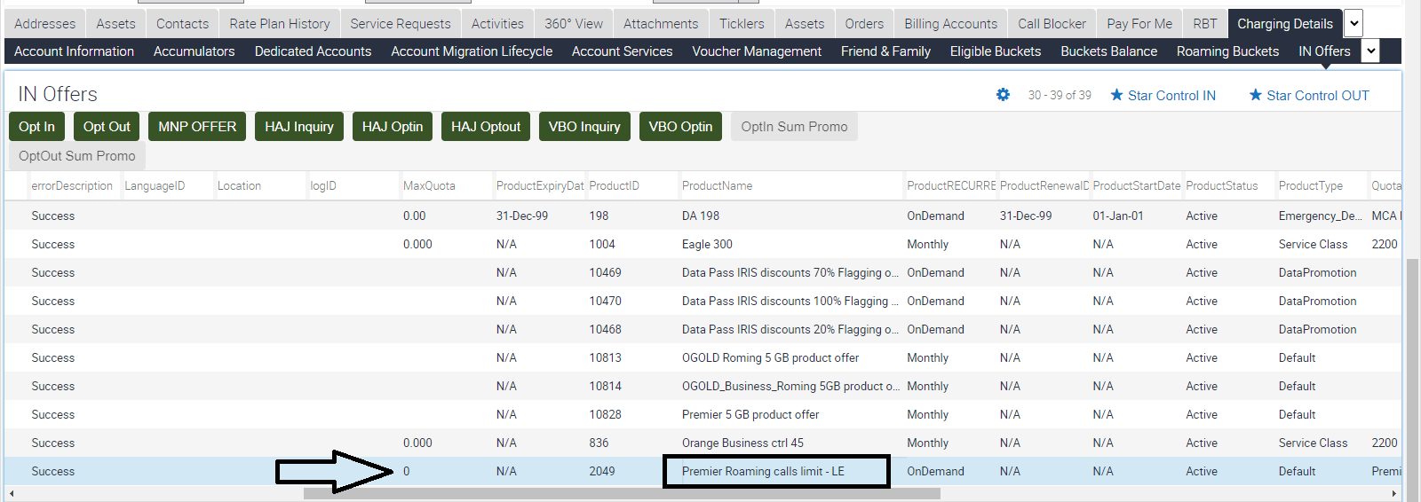
Troubleshooting Steps :
2- Check if customer used his roaming calls limit or not through IN offers, if the limit is set to 0 then customer is unlimited and we can proceed with the needed steps, if limit is set to a certain number and remaining is 0 so customer exceeded his limit, mail should be sent to IT solution to reset customer’s limit.
Limited customer unlimited customer

Slide 6
Troubleshooting Steps :
3- Inform the customer to remove SIM card for 1 minute then re-insert it again.
4- Let the customer select one of our operators manually.
Check our operators : Press Here
5- inform the customer that a refreshment step will be taken from your side after the call, deactivate roaming world and activate it again as per below :

Slide 7
Troubleshooting Steps :
6- Inform the customer to activate caller ID through dialing #31# for any device.
7- Inform the customer to deactivate dial assistant from device settings, and dial the country code before any number he calls. “for example is he calling Egyptian number then customer must dial +2012xxxxxxxx”
Take Care that customer must use + before country code. For reference check the technical guide.
8- In case customer called again and informed that previous steps have been done, yet problem still exists, you should double-check if every step mentioned before is done on Siebel, after this you should put call on hold and call Core Roaming hunt to check with them the problem.
2 trials to reach the hunt should be done to check if there is any other step needed before sending the mail to them.
Core Roaming hunt : 01221603656 – available 24/7

Slide 8
2- Cannot access network

Slide 9
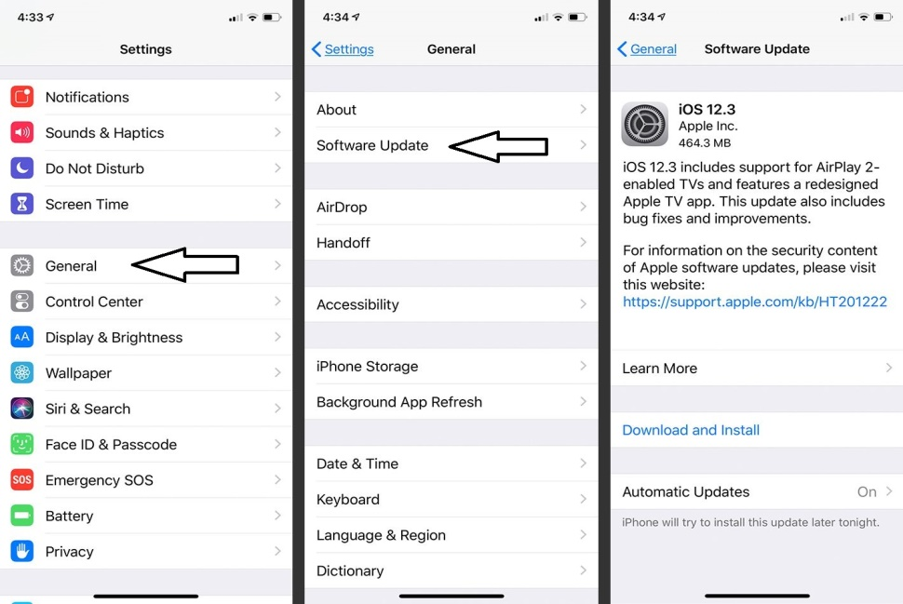
Troubleshooting Steps :
1- You must make sure customer has no active SD or suspension, active roaming world and barring of all our international calls is deactivated. Make sure customer is not activating airplane mode.
2- In case customer is using iPhone, let customer make sure that latest ios version is updated.
Below screenshots of needed actions :
Open Settings
General
Software Update

Slide 10
Troubleshooting Steps :
2- Inform the customer to remove SIM card for 1 minute then re-insert it again.
3- Let the customer select one of our operators manually.
Check our operators : Press Here
4- Check if customer using Dual SIM in his mobile or E-SIM, and ask him to try the SIM card individually using another handset if available.
5- If customer doesn’t see any operator while making manual search then it’s coverage issue, also please advise the customer to try another handset.

Slide 11
Troubleshooting Steps :
6- Inform the customer that a refreshment step will be taken from your side after the call, deactivate roaming world and activate it again as per below :

Slide 12
Troubleshooting Steps :
7- In case customer made all the previous troubleshooting and he can find the operators using manual search but he cannot latch to any operator then you should refer to Core Roaming :
2 trials to reach the hunt should be done to check if there is any other step needed before sending the mail to them reference to the template in the last slide.
Core Roaming hunt : 01221603656 – available 24/7
Hint :
For Customers complains they cannot reach our long number only while making calls normally, you should only check the dial assistant step and let customer try, if not solved thanks to refer to Core Roaming to check if they need a trial on different operator.

Slide 13
3- Cannot Send or receive SMS

Slide 14
Troubleshooting Steps :
1- You must make sure customer has no active SD or suspension, active roaming world and barring of all our international calls is deactivated.
2- Make sure that Short Message Org & Short Message Term is active, a refreshment action also is needed by deactivating it and re-activate it again.
3- Make Sure that SMS Center number is updated in the right format. Check the technical guide for reference.
Hint :
Please make sure that customer is not sending message to short number, in case the problem is related to this, thanks to let the customer make sure through the vendor that this number is available to receive SMS for abroad, as some short numbers cannot receive calls or SMS for outside Egypt.

Slide 15
Troubleshooting Steps :
4- In case all steps is applied and problem still exists, you should refer to Core Roaming :
2 trials to reach the hunt should be done to check if there is any other step needed before sending the mail to them.
Core Roaming hunt : 01221603656 – available 24/7

Slide 16
4- Cannot receive OTP

Slide 17
Troubleshooting Steps :
1- You must make sure customer has no active SD or suspension, active roaming world and barring of all our international calls is deactivated.
2- Check with customer if he is receiving SMS normally or it should be check as cannot receive SMS case.
3- If case is related to OTP only from a certain app, let customer try another app and check if he/she will receive OTP or not, if he/she received OTP normally from another app then it’s an application issue.
4- In case customer cannot receive any OTP, then problem should be check with Core Roaming directly.
-Take care please that prepaid & hybrid customers cannot send or receive any SMS to short numbers while roaming.
2 trials to reach the hunt should be done to check if there is any other step needed before sending the mail to them reference to the template in the last slide.
Core Roaming hunt : 01221603656 – available 24/7

Slide 18
5- Cannot Access Data Roaming

Slide 19
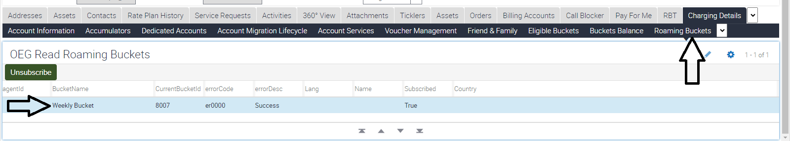
Troubleshooting Steps :
1- You must make sure customer has no active SD or suspension, active roaming world and barring of all our international calls is deactivated.
2- You must make sure that the SIM card on 4G SIM, as 3G SIM cards might not use internet while Roaming.
3- Make sure that data roaming option is activated from device settings. Check the technical guide for reference.
4- Make sure that is there is a bucket is added on Seibel, and also that country is updated as per below :

Slide 20
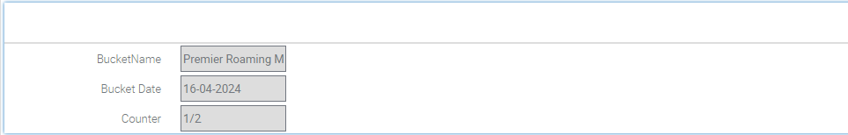
Troubleshooting Steps :
5- For Premier Customers, Agent has to check the premier roaming counter before confirming with the customer that bucket will be triggered,
- For this case troubleshooting should be completed as bucket should be triggered.

Slide 21
Troubleshooting Steps :
6- For Premier Customers, Agent has to check the premier roaming counter before confirming with the customer that bucket will be triggered,
- For this case No troubleshooting should be Done as bucket will not be triggered, Agent has to migrate to another data roaming bucket.

Slide 22
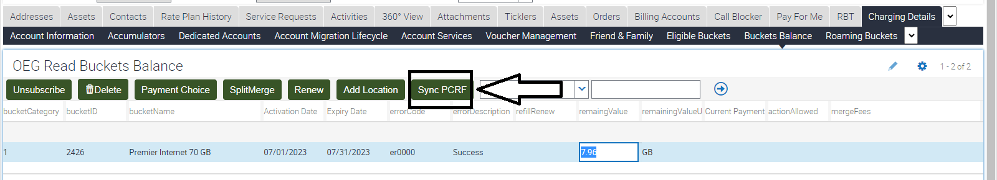
Troubleshooting Steps :
7- Take the action through bucket balance “Sync PCRF” as per below :

Slide 23
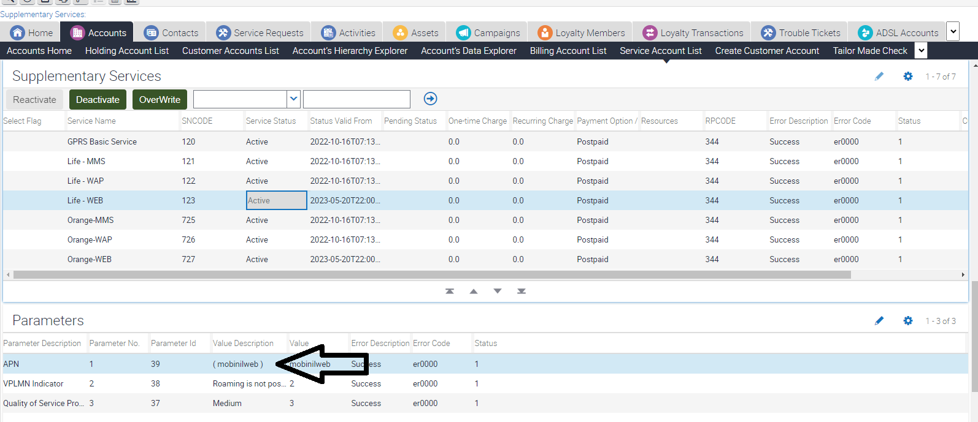
Troubleshooting Steps :
8- Check the Orangeweb & Lifeweb through Seibel, first check that parameters is updated correctively as per below, then take the needed refreshment action by deactivate and reactivate it again :
Hint : Don’t take the refershment action for both at the same time, deactivate orangeweb first then lifeweb, then activate lifeweb first then orangeweb

Slide 24
Troubleshooting Steps :
9- Inform the customer to remove SIM card for 1 minute then re-insert it again.
10- let the customer select one of our operators manually.
Check our operators : Press Here
11- Inform the customer that you call him back after 15 minutes to check his issue.
12- In case problem is not solved, then a normal complaint should be sent to Data team to check the issue providing all the needed data and a contact number, and inform the customer issue will be checked within 4 Working hours. No Need to contact Core roaming team for such case.

Slide 25
Important hints &tips :
Don’t Forget to create Roaming Call deduction SR in case you called customer back for any reason.
For the Data Troubleshooting step no. 5, in case you find that orange web & life web parameters is set to orangeweba & mobinilweba instead of orangeweb & mobinilweb, complain should be sent to FC BO with screenshot without any further steps as per below :
Short code | 10158
Type | Acc Mod For Billing
Area | FC Roaming Call Deduction
Product | Invoice Flag
Sub Area | Done / Closed after filling SS

Slide 26
Seibel SRs :
Short code | 31409
Type | Fault For VAS
Area | Cannot Make And Receive Call
Product | Roaming
Concerned team | FC / Postpaid – FC assist team Prepaid – Prepaid complaint handling
Short code | 31406
Type | Fault For VAS
Area | Cannot Access Network
Product | Roaming
Concerned team | FC / Postpaid – FC assist team Prepaid – Prepaid complaint handling
Short code | 31440
Type | Fault For VAS
Area | Cannot Send or Receive
Product | SMS
Concerned team | FC / Postpaid – FC assist team Prepaid – Prepaid complaint handling
Short code | 30437
Type | Fault For Data Services
Area | Data Roaming prob
Product | Telephony
Concerned team | Data Team – 4 WH

Slide 27
Thank You

